Slide 1
Artificial Intelligence CS-202
Topic: Advance Topics NN and Fuzzy Systems
Habiba Arshad
Department of Computer Science
University of Wah

Slide 2
Week-16 CLO’s
This week lecture will cover the following CLO’s:
CLO1: Discuss the key concepts in the field of artificial intelligence

Slide 3
CLO’s Mapping
CLO 1:
Introduction to Neural Networks

Slide 4
Advance Topics NN and Fuzzy Systems

Slide 5
Neural Networks
A neural network is a machine learning technique that uses artificial intelligence (AI) to teach computers to process data.
Neural networks are based on the human brain, with interconnected nodes called neurons that are organized in layers.
Inspired by the human brain.
Composed of neurons (nodes) connected by weights
Example: Face recognition, speech processing, etc.

Slide 6
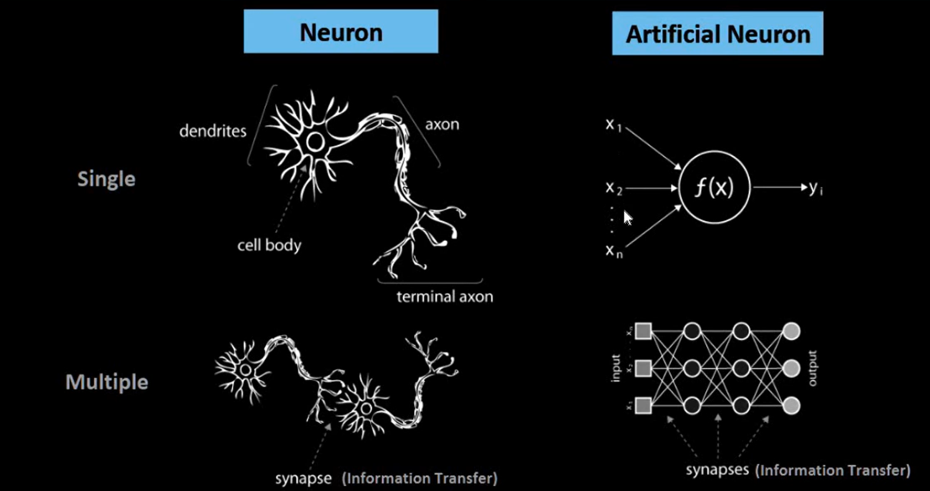
Human Brain vs Neural Network

Slide 7
Human Brain vs Neural Network
A biological neuron consists of four main parts:
Dendrites: These are the input channels of the neuron. They receive signals from other neurons.
Cell Body (Soma): This contains the nucleus and is responsible for processing the incoming signals.
Axon: This transmits the processed signal away from the cell body.
Axon Terminals: These are the endpoints where the signals are passed on to other neurons. They play a crucial role in signal transmission through synapses.
The synapse acts as the information transfer mechanism—it allows one neuron to communicate with another, forming a vast, interconnected network.

Slide 8
Human Brain vs Neural Network
Artificial Neuron: The Perceptron
To simulate this structure in artificial intelligence, we use a simplified model known as the perceptron.
Inputs: The perceptron receives multiple inputs, typically denoted as x1,x2,…,xn representing an n-dimensional input vector.
Processing Function: These inputs are passed into a function that performs a weighted sum and applies an activation function to determine the output.
Output: The result is a single output value, which can be passed to other neurons in a network.
This artificial neuron mimics the input-processing-output cycle of a biological neuron.

Slide 9
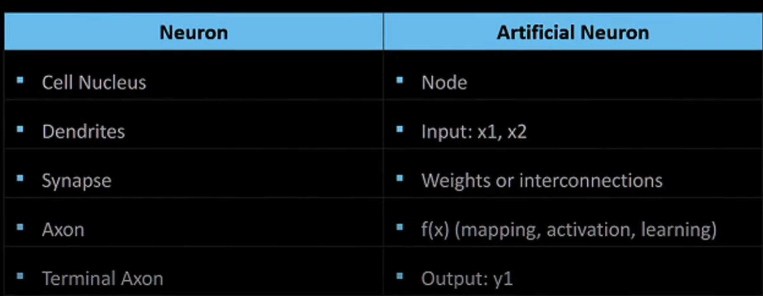
Human Brain vs Neural Network

Slide 10
Neural Network
While a perceptron represents a single neuron, neural networks consist of multiple such neurons, interconnected through synapses (i.e., weighted connections).
These neurons are arranged in layers:
Input Layer
Hidden Layers
Output Layer
Each layer transforms the data and passes it forward, allowing the network to learn complex patterns.

Slide 11
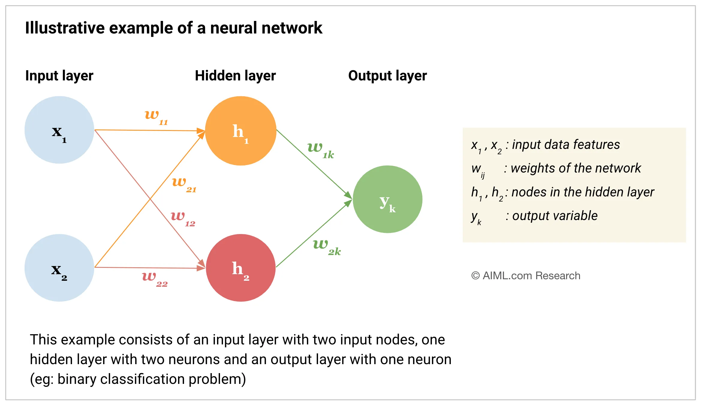
Overview

Slide 12
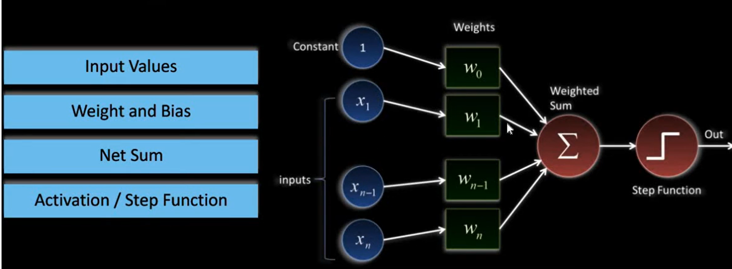
Perceptron
The perceptron is a foundational unit in neural networks, designed as a computational replica of the biological neuron. It is also the name of an early algorithm for supervised learning of binary classifiers

Slide 13
Components
Inputs:
These are the features or data points fed into the perceptron.
Analogous to dendrites in biological neurons.
Weights and Bias:
Each input is associated with a weight w1,w2,...,wn​.
There is also a bias term b, which helps shift the activation function.
These weights and bias are learnable parameters, similar to coefficients in linear or polynomial regression.

Slide 14

Structure of a Neural Network
Net Input (Weighted Sum):This is computed using the formula:
This represents the linear combination of inputs and weights, just like in regression models.
Activation Function:
The activation function decides the output of the perceptron based on the weighted sum.
It can be:
Linear (e.g., identity function, in regression problems)
Non-linear (e.g., sigmoid, ReLU, tanh — commonly used in deep learning)
The choice of activation allows the network to learn complex, non-linear decision boundaries.

Slide 15
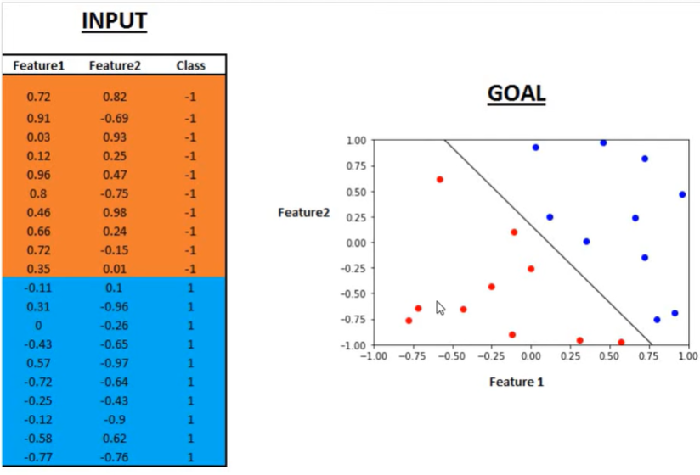
Notes:
https://youtu.be/R2AXVUwBh7A

Slide 16
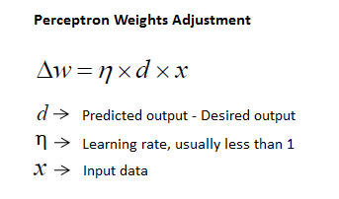
Perceptron Learning Rule
Initialize weights randomly
Compute output
Adjust weights based on error
Repeat until the error is minimized

Slide 17
Limitation of Perceptron
Cannot solve non-linearly separable problems (e.g., XOR problem)
Only works for simple tasks
Solution: Use Multi-Layer Networks & Backpropagation
Non-linearly separable problems
A "non-linearly separable problem" in machine learning refers to a dataset where the different classes of data cannot be separated by a straight line (or hyperplane in higher dimensions), meaning a simple linear model cannot effectively classify the data, and more complex non-linear functions are required to distinguish between the classes.

Slide 18
Backpropagation Algorithm
Backpropagation is a fundamental algorithm used to train artificial neural networks, particularly feed-forward neural networks.
It is an iterative method that helps minimize the cost function by adjusting the weights and biases of the network.
This process involves two main passes:
forward pass
backward pass.

Slide 19
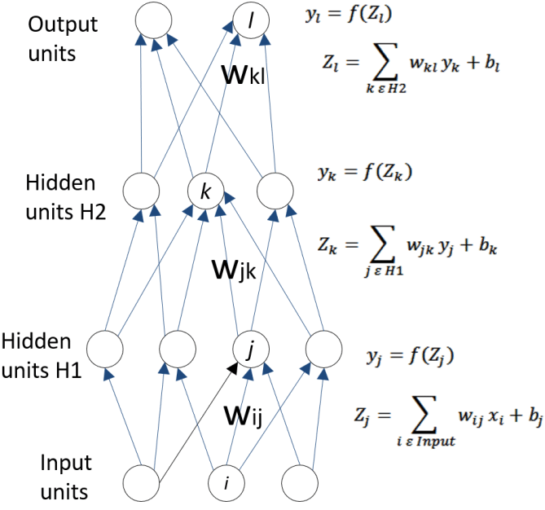
Forward Pass
In the forward pass, the input data is fed into the input layer of the neural network.
The inputs are then passed through the hidden layers, where each neuron computes a weighted sum of its inputs, adds a bias, and applies an activation function.
The output of each hidden layer is used as the input for the next layer.
Finally, the output layer produces the network's prediction.

Slide 20
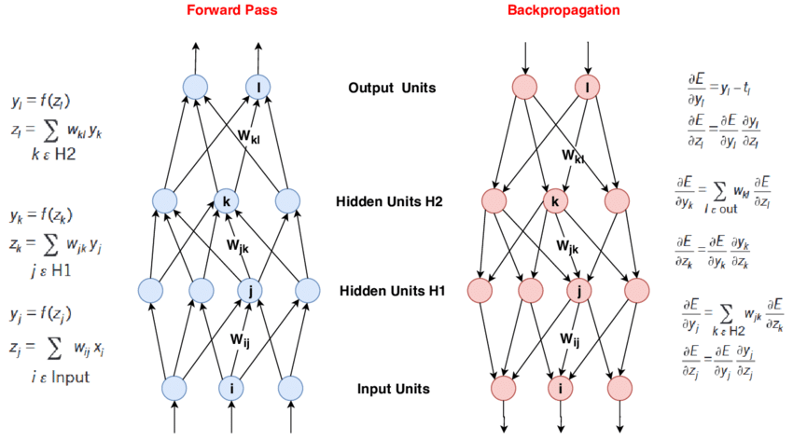
Backward Pass
In the backward pass, the error is propagated back through the network to update the weights and biases.
The error is calculated as the difference between the predicted output and the actual output.
The gradients of the error with respect to each weight and bias are computed using the chain rule.
These gradients indicate how much each weight and bias should be adjusted to minimize the error.
Notes:
Gradient descent is the backbone of the learning process for various algorithms, including linear regression, logistic regression, support vector machines, and neural networks which serves as a fundamental optimization technique to minimize the cost function of a model by iteratively adjusting the model parameters to reduce the difference between predicted and actual values, improving the model's performance.
Backpropagation in Neural Network - GeeksforGeeks

Slide 21
The backpropagation algorithm is essential for training neural networks as it efficiently computes the gradients needed to update the weights and biases, enabling the network to learn from data and make accurate predictions

Slide 22
Fuzzy Logics
Introduction to Fuzzy Logic
Why Fuzzy? Traditional logic is binary (0 or 1), but the real world is uncertain.
Fuzzy Logic allows for partial truths (e.g., "somewhat cold" or "very hot").
Used in decision-making, control systems, and AI.
Fuzzy Logic vs. Classical Logic
Classical Logic (Binary) | Fuzzy Logic
Yes or No (0 or 1) | Degrees of truth (0 to 1)
Rigid decision-making | Handles uncertainty
Example: Light is ON/OFF | Example: Light is Dim, Bright, Medium

Slide 23
Fuzzy and Hybrid Intelligent Systems
Combines Neural Networks + Fuzzy Logic
Why Hybrid?
Neural Networks learn from data
Fuzzy Logic handles uncertainty
Together, they improve AI systems
Example: Self-driving cars use Neural Networks for vision & Fuzzy Logic for decision-making.

Slide 24
Summary & Applications
Neural Networks: Used in pattern recognition, deep learning
Perceptron: Basic NN, limited to simple problems
Backpropagation: Trains deep networks using error correction
Fuzzy Logic: Handles uncertainty in AI systems
Hybrid Systems: Combine multiple AI techniques for better accuracy

